Slide 1
Microprocessor 8085

Slide 2
Basic Concepts of Microprocessors
Differences between:
Microcomputer –a computer with a microprocessor as its CPU. Includes memory, I/O etc.
Microprocessor –silicon chip which includes ALU, register circuits & control circuits
Microcontroller –silicon chip which includes microprocessor, memory & I/O in a single package.

Slide 3
What is a Microprocessor?
The word comes from the combination micro and processor.
Processor means a device that processes whatever. In this context processor means a device that processes numbers, specifically binary numbers, 0’s and 1’s.
To process means to manipulate. It is a general term that describes all manipulation. Again in this content, it means to perform certain operations on the numbers that depend on the microprocessor’s design.

Slide 4
What about micro?
Micro is a new addition.
In the late 1960’s, processors were built using discrete elements.
These devices performed the required operation, but were too large and too slow.
In the early 1970’s the microchip was invented. All of the components that made up the processor were now placed on a single piece of silicon. The size became several thousand times smaller and the speed became several hundred times faster. The “Micro”Processor was born.

Slide 5
Was there ever a “mini”-processor?
No.
It went directly from discrete elements to a single chip. However, comparing today’s microprocessors to the ones built in the early 1970’s you find an extreme increase in the amount of integration.
So, What is a microprocessor?

Slide 6
Definition of the Microprocessor
The microprocessor is a programmable device that takes in numbers, performs on them arithmetic or logical operations according to the program stored in memory and then produces other numbers as a result.

Slide 7
Definition (Contd.)
Lets expand each of the underlined words:
Programmable device: The microprocessor can perform different sets of operations on the data it receives depending on the sequence of instructions supplied in the given program. By changing the program, the microprocessor manipulates the data in different ways.
Instructions: Each microprocessor is designed to execute a specific group of operations. This group of operations is called an instruction set. This instruction set defines what the microprocessor can and cannot do.

Slide 8
Definition (Contd.)
Takes in: The data that the microprocessor manipulates must come from somewhere.
It comes from what is called “input devices”.
These are devices that bring data into the system from the outside world.
These represent devices such as a keyboard, a mouse, switches, and the like.

Slide 9
Definition (Contd.)
Numbers: The microprocessor has a very narrow view on life. It only understands binary numbers.
A binary digit is called a bit (which comes from binary digit).
The microprocessor recognizes and processes a group of bits together. This group of bits is called a “word”.
The number of bits in a Microprocessor’s word, is a measure of its “abilities”.

Slide 10
Definition (Contd.)
Words, Bytes, etc.
The earliest microprocessor (the Intel 8088 and Motorola’s 6800) recognized 8-bit words.
They processed information 8-bits at a time. That’s why they are called “8-bit processors”. They can handle large numbers, but in order to process these numbers, they broke them into 8-bit pieces and processed each group of 8-bits separately.
Later microprocessors (8086 and 68000) were designed with 16-bit words.
A group of 8-bits were referred to as a “half-word” or “byte”.
A group of 4 bits is called a “nibble”.
Also, 32 bit groups were given the name “long word”.
Today, all processors manipulate at least 32 bits at a time and there exists microprocessors that can process 64, 80, 128 bits.

Slide 11
Definition (Contd.)
Arithmetic and Logic Operations:
Every microprocessor has arithmetic operations such as add and subtract as part of its instruction set.
Most microprocessors will have operations such as multiply and divide.
Some of the newer ones will have complex operations such as square root.
In addition, microprocessors have logic operations as well. Such as AND, OR, XOR, shift left, shift right, etc.
Again, the number and types of operations define the microprocessor’s instruction set and depends on the specific microprocessor.

Slide 12
Definition (Contd.)
Stored in memory :
First, what is memory?
Memory is the location where information is kept while not in current use.
Memory is a collection of storage devices. Usually, each storage device holds one bit. Also, in most kinds of memory, these storage devices are grouped into groups of 8. These 8 storage locations can only be accessed together. So, one can only read or write in terms of bytes to and form memory.
Memory is usually measured by the number of bytes it can hold. It is measured in Kilos, Megas and lately Gigas. A Kilo in computer language is 2¹⁰ =1024. So, a KB (KiloByte) is 1024 bytes. Mega is 1024 Kilos and Giga is 1024 Mega.

Slide 13
Definition (Contd.)
Stored in memory:
When a program is entered into a computer, it is stored in memory. Then as the microprocessor starts to execute the instructions, it brings the instructions from memory one at a time.
Memory is also used to hold the data.
The microprocessor reads (brings in) the data from memory when it needs it and writes (stores) the results into memory when it is done.

Slide 14
Definition (Contd.)
Produces: For the user to see the result of the execution of the program, the results must be presented in a human readable form.
The results must be presented on an output device.
This can be the monitor, a paper from the printer, a simple LED or many other forms.

Slide 15
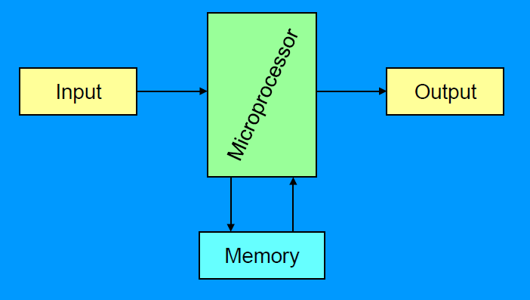
A Microprocessor-based system
From the above description, we can draw the following block diagram to represent a microprocessor-based system:

Slide 16
Inside the Microprocessor
Internally, the microprocessor is made up of 3 main units.
The Arithmetic/Logic Unit (ALU)
The Control Unit.
An array of registers for holding data while it is being manipulated.

Slide 17
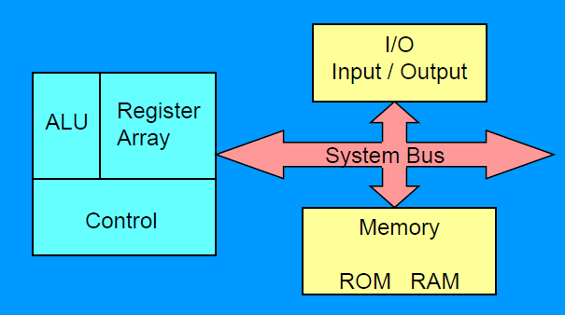
Organization of a microprocessor-based system
Let’s expand the picture a bit.

Slide 18
Memory
Memory stores information such as instructions and data in binary format (0 and 1). It provides this information to the microprocessor whenever it is needed.
Usually, there is a memory “sub-system” in a microprocessor-based system. This sub-system includes:
The registers inside the microprocessor
Read Only Memory (ROM)
used to store information that does not change.
Random Access Memory (RAM) (also known as Read/Write Memory).
used to store information supplied by the user. Such as programs and data.

Slide 19
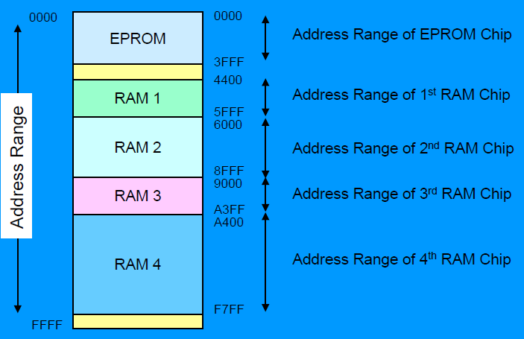
Memory Map and Addresses
The memory map is a picture representation of the address range and shows where the different memory chips are located within the address range.

Slide 20
Memory
To execute a program:
the user enters its instructions in binary format into the memory.
The microprocessor then reads these instructions and whatever data is needed from memory, executes the instructions and places the results either in memory or produces it on an output device.

Slide 21
The three cycle instruction execution model
To execute a program, the microprocessor “reads” each instruction from memory, “interprets” it, then “executes” it.
To use the right names for the cycles:
The microprocessor fetches each instruction,
Decodes it,
Then executes it.
This sequence is continued until all instructions are performed.

Slide 22
Machine Language
The number of bits that form the “word” of a microprocessor is fixed for that particular processor.
These bits define a maximum number of combinations.
For example an 8-bit microprocessor can have at most 2⁸ = 256 different combinations.
However, in most microprocessors, not all of these combinations are used.
Certain patterns are chosen and assigned specific meanings.
Each of these patterns forms an instruction for the microprocessor.
The complete set of patterns makes up the microprocessor’s machine language.

Slide 23
The 8085 Machine Language
The 8085 (from Intel) is an 8-bit microprocessor.
The 8085 uses a total of 246 bit patterns to form its instruction set.
These 246 patterns represent only 74 instructions.
The reason for the difference is that some (actually most) instructions have multiple different formats.
Because it is very difficult to enter the bit patterns correctly, they are usually entered in hexadecimal instead of binary.
For example, the combination 0011 1100 which translates into “increment the number in the register called the accumulator”, is usually entered as 3C.

Slide 24
Assembly Language
Entering the instructions using hexadecimal is quite easier than entering the binary combinations.
However, it still is difficult to understand what a program written in hexadecimal does.
So, each company defines a symbolic code for the instructions.
These codes are called “mnemonics”.
The mnemonic for each instruction is usually a group of letters that suggest the operation performed.

Slide 25
Assembly Language
Using the same example from before,
00111100 translates to 3C in hexadecimal (OPCODE)
Its mnemonic is: “INR A”.
INR stands for “increment register” and A is short for accumulator.
Another example is: 1000 0000,
Which translates to 80 in hexadecimal.
Its mnemonic is “ADD B”.
“Add register B to the accumulator and keep the result in the accumulator”.

Slide 26
Assembly Language
It is important to remember that a machine language and its associated assembly language are completely machine dependent.
In other words, they are not transferable from one microprocessor to a different one.
For example, Motorolla has an 8-bit microprocessor called the 6800.
The 8085 machine language is very different from that of the 6800. So is the assembly language.
A program written for the 8085 cannot be executed on the 6800 and vice versa.

Slide 27
“Assembling” The Program
How does assembly language get translated into machine language?
There are two ways:
1st there is “hand assembly”.
The programmer translates each assembly language instruction into its equivalent hexadecimal code (machine language). Then the hexadecimal code is entered into memory.
The other possibility is a program called an “assembler”, which does the translation automatically.

Slide 28
8085 Microprocessor Architecture

Slide 29
8085 Microprocessor Architecture
8-bit general purpose μp
Capable of addressing 64 k of memory
Has 40 pins
Requires +5 v power supply
Can operate with 3 MHz clock
8085 upward compatible

Slide 30
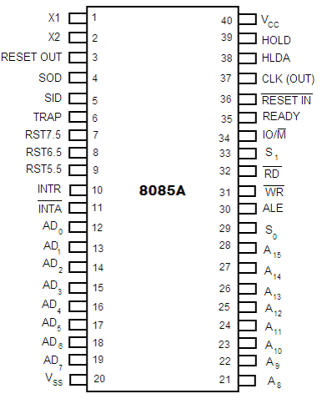
Pins
Frequency Generator is connected to those pins
Power Supply +5V
Input/Output/Memory
Read & Write
Address Latch Enable
Multiplexed Address Data Bus
Address Bus

Slide 31
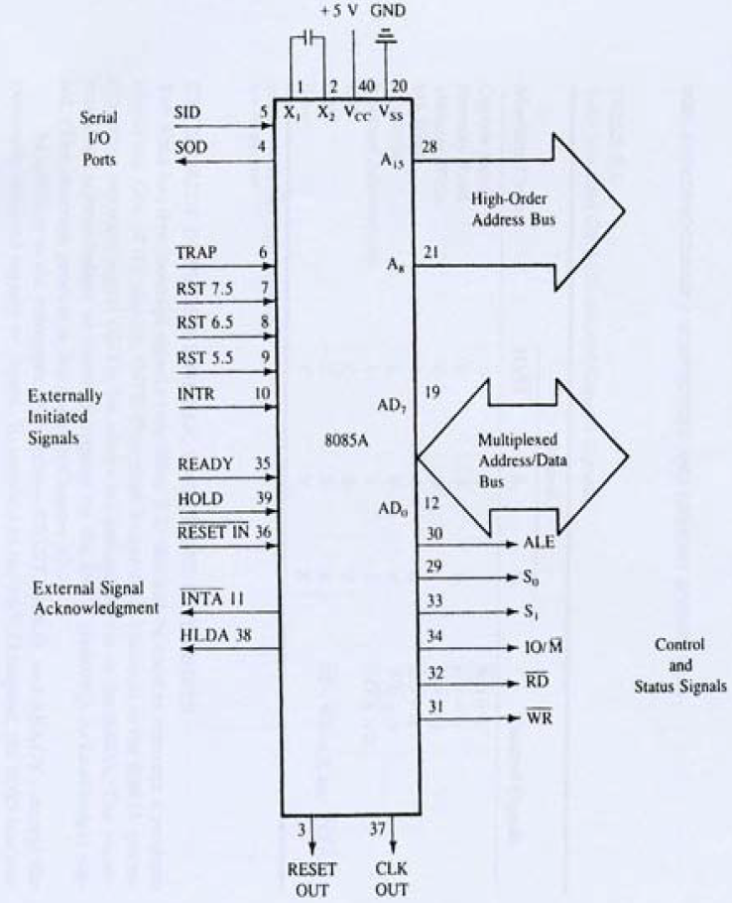

Slide 32
System Bus –wires connecting memory & I/O to microprocessor
Address Bus
Unidirectional
Identifying peripheral or memory location
Data Bus
Bidirectional
Transferring data
Control Bus
Synchronization signals
Timing signals
Control signal

Slide 33
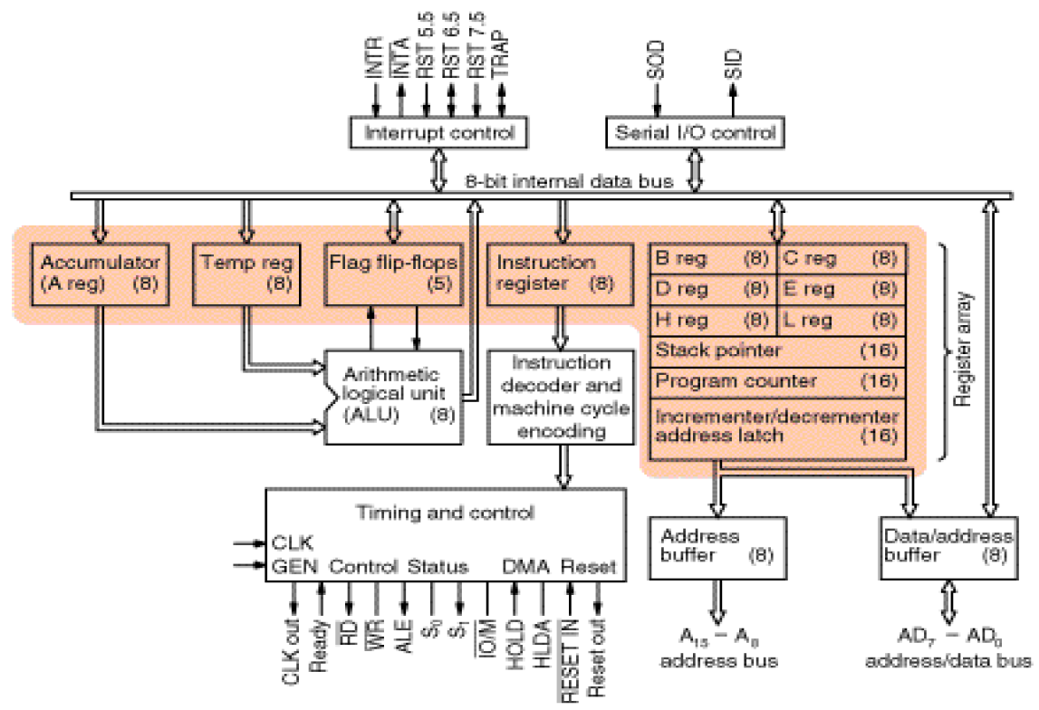
8085 Architecture

Slide 34
Intel 8085 Microprocessor
Microprocessor consists of:
Control unit: control microprocessor operations.
ALU: performs data processing function.
Registers: provide storage internal to CPU.
Interrupts
Internal data bus

Slide 35
ALU
In addition to the arithmetic & logic circuits, the ALU includes the accumulator, which is part of every arithmetic & logic operation.
Also, the ALU includes a temporary register used for holding data temporarily during the execution of the operation. This temporary register is not accessible by the programmer.

Slide 36
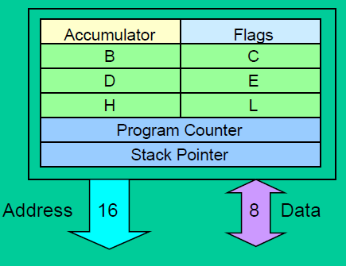
Registers
General Purpose Registers
B, C, D, E, H& L(8 bit registers)
Can be used singly
Or can be used as 16 bit register pairs
BC, DE, HL
H & L can be used as a data pointer (holds memory address)
Special Purpose Registers
Accumulator(8 bit register)
Store 8 bit data
Store the result of an operation
Store 8 bit data during I/O transfer

Slide 37
Cont…
Flag Register
8 bit register –shows the status of the microprocessor before/after an operation
S (sign flag), Z (zero flag), AC (auxiliary carry flag), P (parity flag) & CY (carry flag)

Slide 38
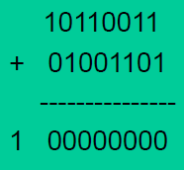
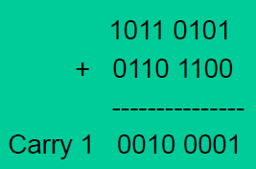
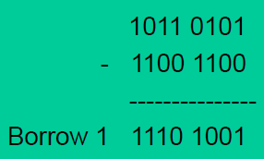
Zero Flag
Is set if result obtained after an operation is 0
Is set following an increment or decrement operation of that register
Carry Flag
Is set if there is a carry or borrow from arithmetic operation

Slide 39
Auxiliary Carry Flag
Now let us consider the addition of any two 8-bit (2-hex digit) numbers, a carry may be generated when we add the LS hex digits of the two numbers. Such a carry is called intermediate carry also known as half carry, or auxiliary carry (AC). Intel prefers to call it AC
Parity Flag
Is set if parity is even
Is cleared if parity is odd

Slide 40
The Internal Architecture
We have already discussed the general purpose registers, the Accumulator, and the flags.
The Program Counter (PC)
This is a register that is used to control the sequencing of the execution of instructions.
This register always holds the address of the next instruction.
Since it holds an address, it must be 16 bits wide.

Slide 41
The Internal Architecture
The Stack pointer
The stack pointer is also a 16-bit register that is used to point into memory.
The memory this register points to is a special area called the stack.
The stack is an area of memory used to hold data that will be retrieved soon.
The stack is usually accessed in a Last In First Out (LIFO) fashion.

Slide 42
Non Programmable Registers
Instruction Register & Decoder
Instruction is stored in IR after fetched by processor
Decoder decodes instruction in IR

Slide 43
Internal Clock generator
3.125 MHz internally
6.25 MHz externally

Slide 44
The Address and Data Busses
The address bus has 8 signal lines A₈ –A₁₅ which are unidirectional.
The other 8 address bits are multiplexed(time shared) with the 8 data bits.
So, the bits AD₀ –AD₇ are bi-directional and serve as A₀ –A₇ and D₀ –D₇ at the same time.
During the execution of the instruction, these lines carry the address bits during the early part, then during the late parts of the execution, they carry the 8 data bits.
In order to separate the address from the data, we can use a latch to save the value before the function of the bits changes.

Slide 45
Demultiplexing AD₇-AD₀
From the above description, it becomes obvious that the AD₇–AD₀ lines are serving a dual purpose and that they need to be demultiplexed to get all the information.
The high order bits of the address remain on the bus for three clock periods. However, the low order bits remain for only one clock period and they would be lost if they are not saved externally. Also, notice that the low order bits of the address disappear when they are needed most.
To make sure we have the entire address for the full three clock cycles, we will use an external latch to save the value of AD₇–AD₀ when it is carrying the address bits. We use the ALE signal to enable this latch.

Slide 46
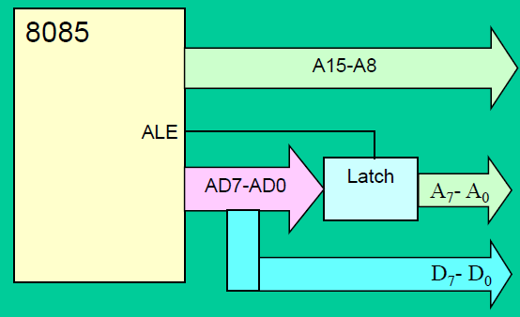
Demultiplexing AD7-AD0
Given that ALE operates as a pulse during T1, we will be able to latch the address. Then when ALE goes low, the address is saved and the AD₇–AD₀ lines can be used for their purpose as the bi-directional data lines.

Slide 47
Demultiplexing the Bus AD₇–AD₀
The high order address is placed on the address bus and hold for 3 clock periods
The low order address is lost after the first clock period, this address needs to be hold however we need to use latch
The address AD₇ –AD₀ is connected as inputs to the latch 74LS373
The ALE signal is connected to the enable (G) pin of the latch and the OC –Output control –of the latch is grounded

Slide 48
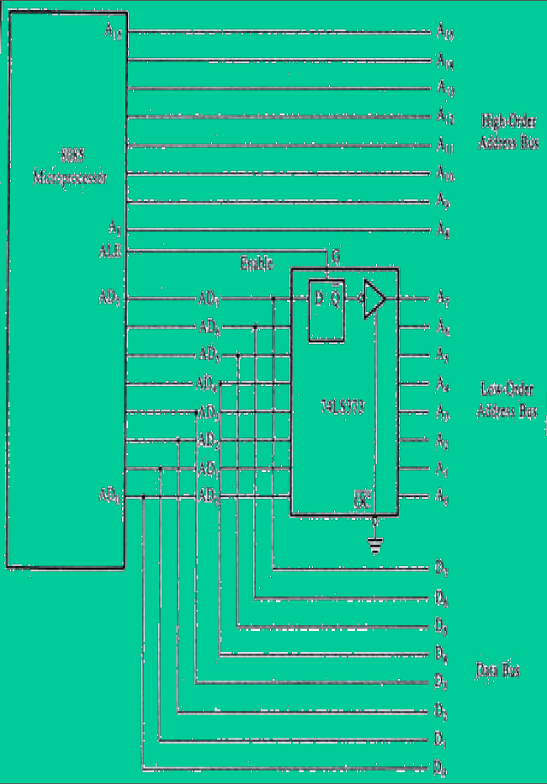

Slide 49
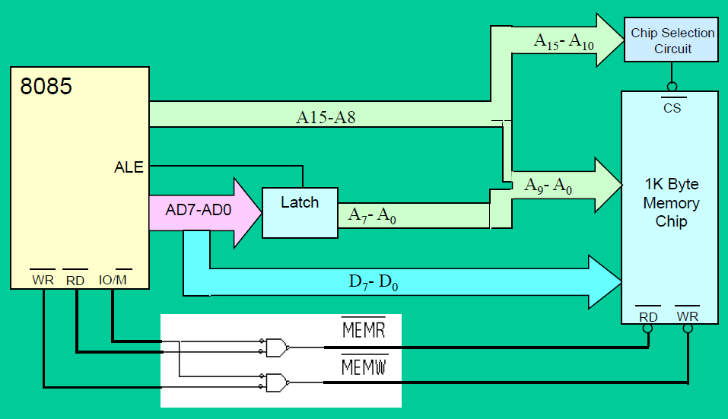
The Overall Picture
Putting all of the concepts together, we get

Slide 50
Interface Section
Number of pins in the interfacing section of the microprocessor depends on the technology of that date.
Cost of an IC depends on the number of pins and the technology of that date.
8085 microprocessor developed in 1976 has 40 pins.
In today’s scenario technology support 256 pins or more for interfacing with external world, i.e. memory and I/O devices.
Through pins different control signals are being communicated.

Slide 51
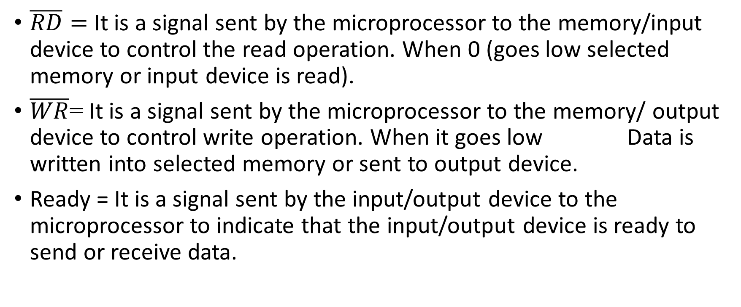
Memory and I/O control lines
$\overline{RD}=$It is a signal sent by the microprocessor to the memory/input device to control the read operation. When 0 (goes low selected memory or input device is read).
$\overline{WR}$= It is a signal sent by the microprocessor to the memory/ output device to control write operation. When it goes low Data is written into selected memory or sent to output device.
Ready = It is a signal sent by the input/output device to the microprocessor to indicate that the input/output device is ready to send or receive data.

Slide 52
ALE = It is a address latch enable signal.
A₈-A₁₅ = These are address bus and are used for the most significant bits of the memory address or I/O address.
AD₀-AD₇ = These are time multiplexed address/data bus, i.e.
ALE=1 | All 16 lines are used as address bus
ALE=0 | A₁₅-A₈ = Address bus
 | AD₇-AD₀=Data bus
First clock cycle of machine cycle | Least significant bits of memory or I/O address
Second and Third clock cycle | Used for data transfer
$IO/\overline{M}$=It is a status signal which distinguishes whether the address is for memory or I/O.

Slide 53
Status lines (S₀ and S₁) = These are the signals sent by the microprocessor to distinguish various types of operations.
CPU and BUS Control lines
HOLD = When another device of the computer system, requires address/data bus for data transfer, it sends HOLD signal to the microprocessor.
S₁ | S₀ | Operation
0 | 0 | HALT
0 | 1 | WRITE
1 | 0 | READ
1 | 1 | FETCH

Slide 54
HLDA = It is a HOLD acknowledge signal sent out by the microprocessor after receiving the HOLD signal.
RESET IN = It reset the program counter, interrupt enable, HLDA flip-flops and instruction register.
RESET OUT = It indicates that the CPU is being reset.
Memory
Microprocessor
DMA Controller
I/O device

Slide 55
Interrupt
Interrupt is an internal or external signal which may disturb or alter the sequence of execution of processor.
It is a method by which an I/O device informs the processor that it requires services of the processor.
Interrupt can be classified as:
Maskable – Interrupt which can be avoided.
Non-Maskable - Interrupt which cannot be ignored or avoided.
Vectored – Interrupt which has specific address location in the memory.
Non-vectored – Interrupt which do not have specific address location in the memory.

Slide 56
Crystal and serial I/O lines
X₁ and X₂ = These are the terminals connected to external crystal oscillator which drives an internal circuitry of the microprocessor.
SID = It is a data line for serial input. The data on this line is loaded into the 7th bit of the accumulator when RIM is executed.
SOD = It is a data line for serial output. The 7th bit of the accumulator is output on SOD line when SIM instruction is executed.

Slide 57
Utility Lines
V_{cc} = +5 V supply
V_{ss} = ground reference
Clock = It is a output for user, which can be used for other digital ICs.

